Slide 1

Project Name Movie review classification
Shai Level 2 Training
NLP Project

Slide 2

Index:
Project description
About dataset
Preprocessing steps
Training Models
Testing result

Slide 3

Project description
Our project is centered on interpreting sentiments from movie reviews. By using machine learning models and deep learning model and pretrained models, to know whether a review reflects a positive or negative sentiment. This knowledge is very important for movie makers. It helps them know how people feel about their movies and how to make better movies in the future.

Slide 4



The process steps
Explore
Data
Analysis
Cleaning Data
Train
ML &Deep Learning Models

Slide 5

About dataset
The Dataset is a binary sentiment analysis dataset. It consists of three file one for training contain 40000 review and the second for validation cotains 5000 reviews and lastly the test file which we want to predict the label for, each file is splited between positive and negative sentiments.
The Dataset contains two types of columns:
text: This column contains the text of the movie review.
label: This column categorizes the review as either positive or negative (1 or 0 ).

Slide 6
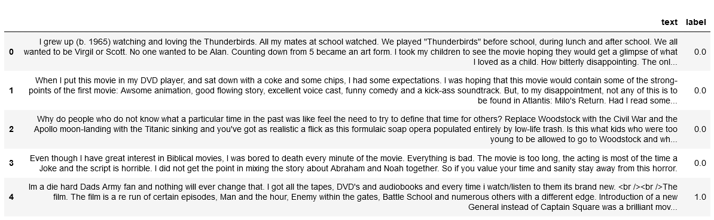
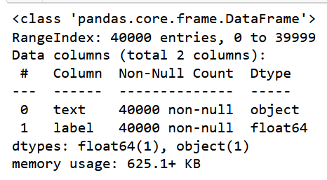
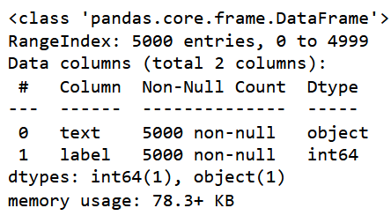
About dataset
A sample from the dataset:
Info about the train , valid data:

Slide 7
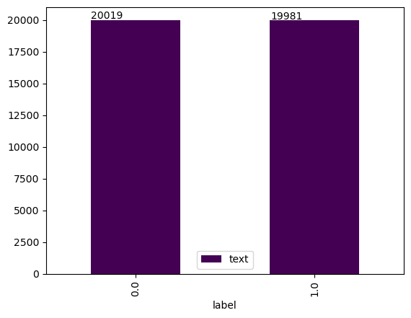
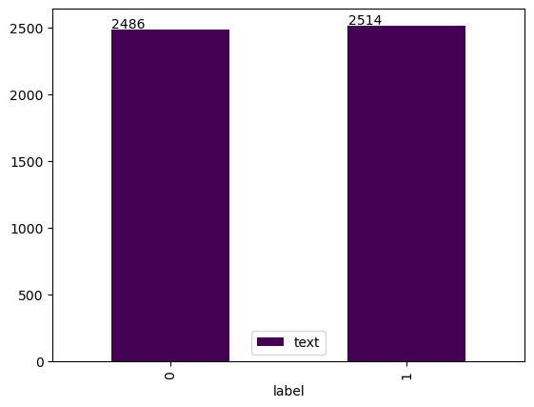
The distribution and percentage of positive and negative reviwes
In Train_df:
In Valid_df:

Slide 8
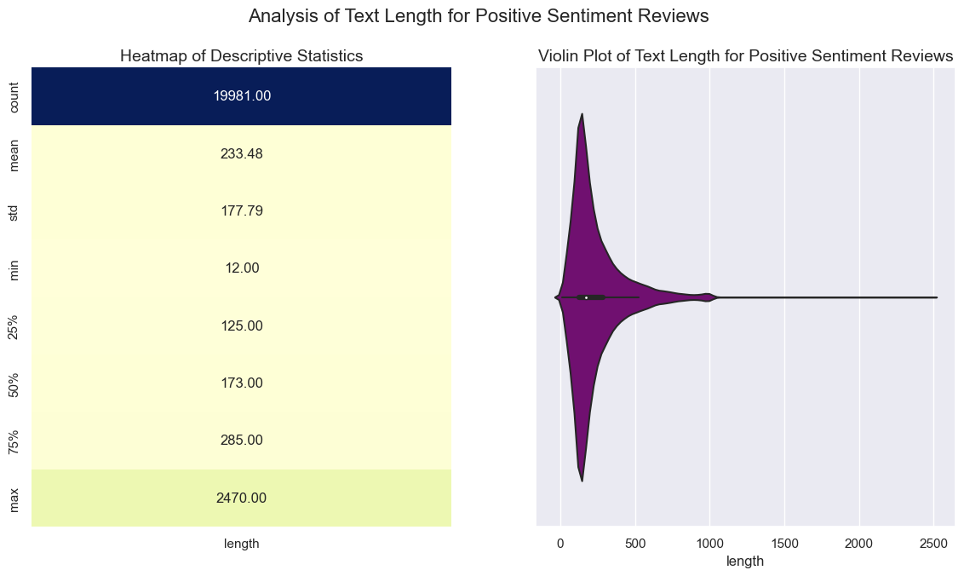
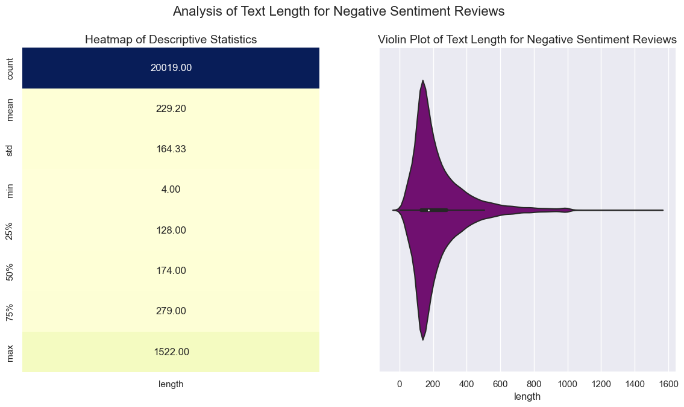
Text length analyis

Slide 9
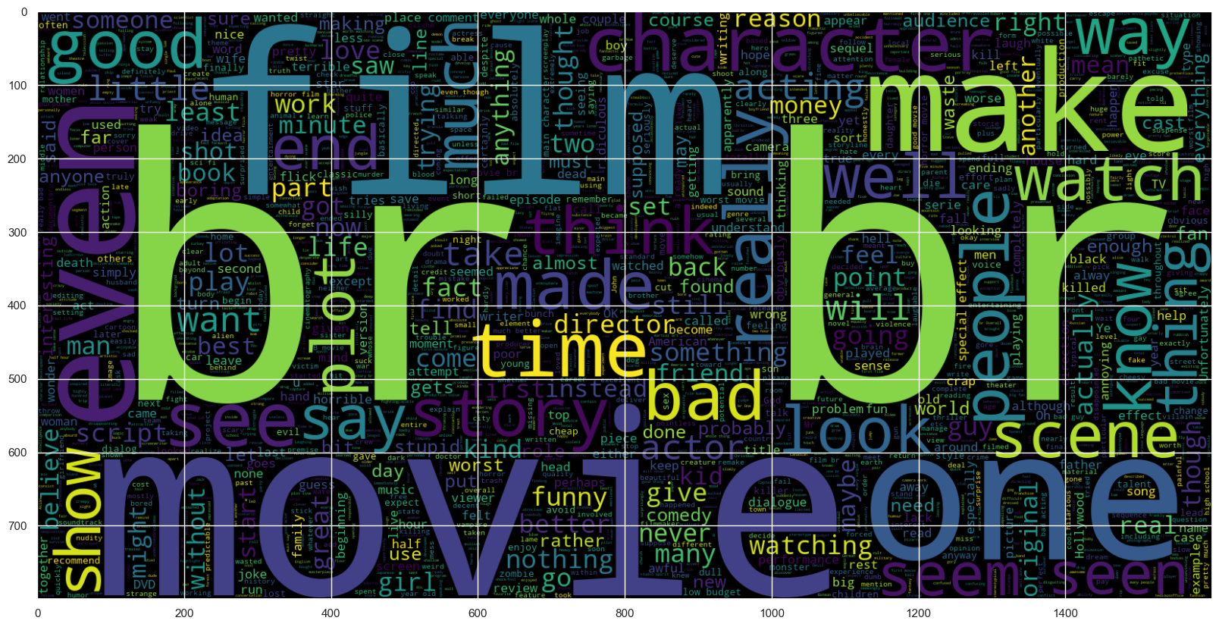
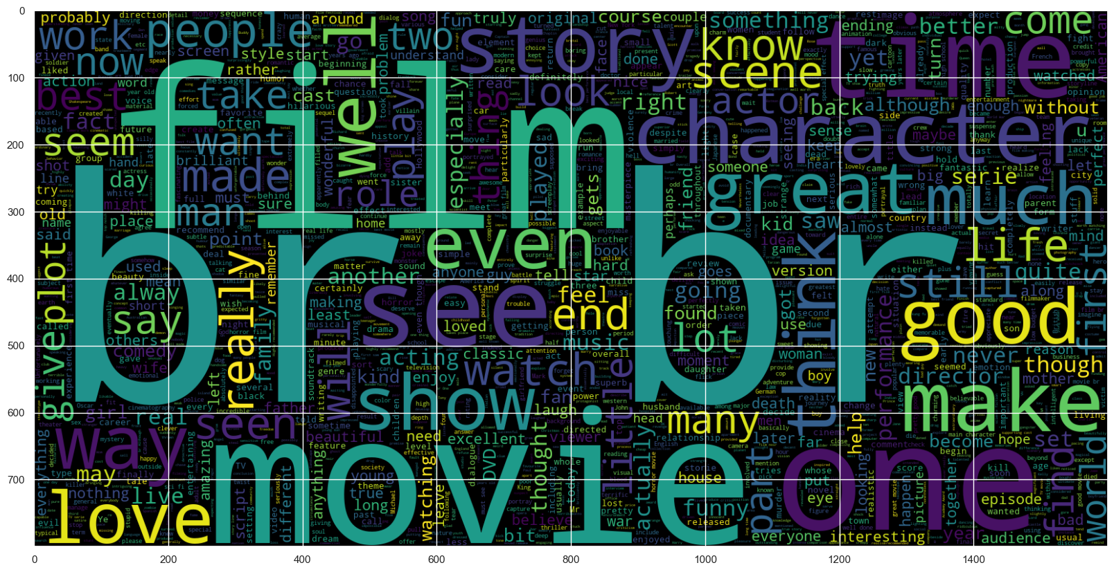
Word Distribution using word cloud
Negative text (Label: 0)
Positive text (Label: 1)

Slide 10
Preprocessing
Cleaning: This step involves removing unnecessary characters like punctuation, special characters, numbers, and common words (also known as stop words) such as "the," "a," "and," etc.
Lowercasing: In this step, all the words are converted to lowercase. This is done to ensure that different cases of the same word are treated as the same. For example, "good" and "Good" are treated as the same word.
Tokenization: This is the process of splitting the text into individual words or phrases, which are known as tokens.
Stemming/Lemmatization: This step simplifies words to their base or root form. Stemming involves removing the suffixes from words, while lemmatization involves reducing words to their base form based on their part of speech.
Feature Encoding: This step involves converting text data into numerical representations that machine learning algorithms can understand. This can be done using various techniques such as one-hot encoding, TF-IDF, or word embedding.
Sentiment Score: In this step, a sentiment score is assigned to each token based on a sentiment lexicon (a dictionary of words and their sentiment polarity).

Slide 11

Machine learning Models
For the machine learning models we used:
1. logistic regression
2. SVM

Slide 12
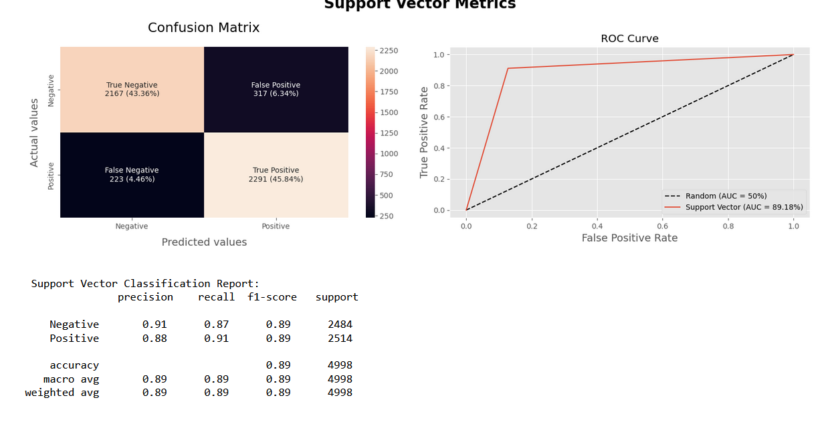
Machine learning Models
SVM

Slide 13
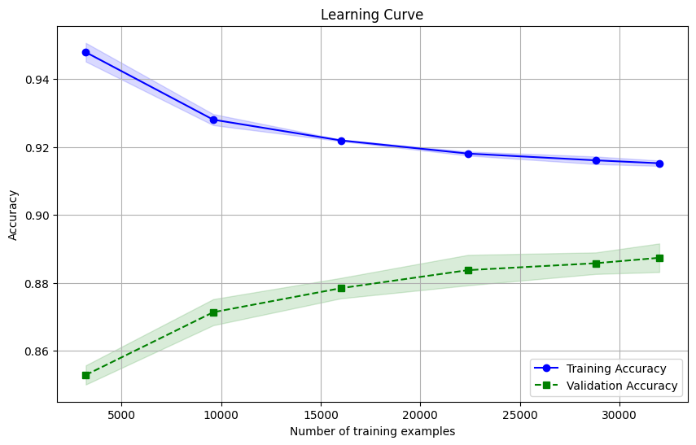
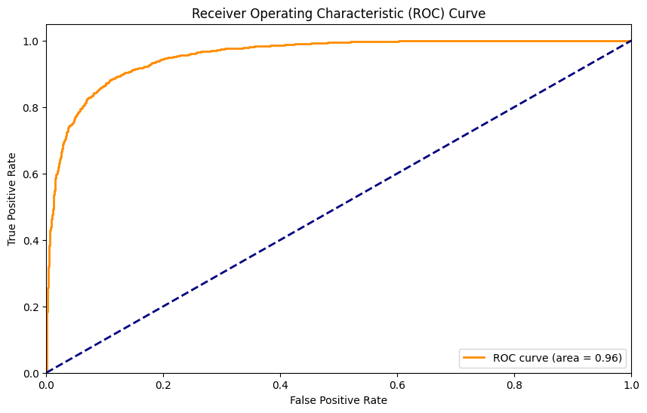
Machine learning Models
Logistic Regression

Slide 14

Deep learning Models
For the machine learning models we used:
1. CNN & Bidirectional GRU &
LSTM
2. CNN & Bidirectional GRU & LSTM with Attention mechanisms

Slide 15
CNN & Bidirectional (GRU & LSTM)
Input Layer: Takes in the data.
Embedding Layer: Converts input data into dense vectors.
SpatialDropout1D Layer: Applies dropout across the spatial dimension.
GlobalAveragePooling1D and GlobalMaxPooling1D Layers: Perform global average and max pooling operations on the convoluted GRU output.
Bidirectional GRU Layer: Captures both past and future context in the sequence.
Conv1D Layer: Applies a convolution operation to the GRU output.
Bidirectional LSTM Layer: Captures both past and future context in the sequence
BatchNormalization Layer: Normalizes the activations of the previous layer.
Dense Layer: The final layer of the model, outputs the predictions.

Slide 16
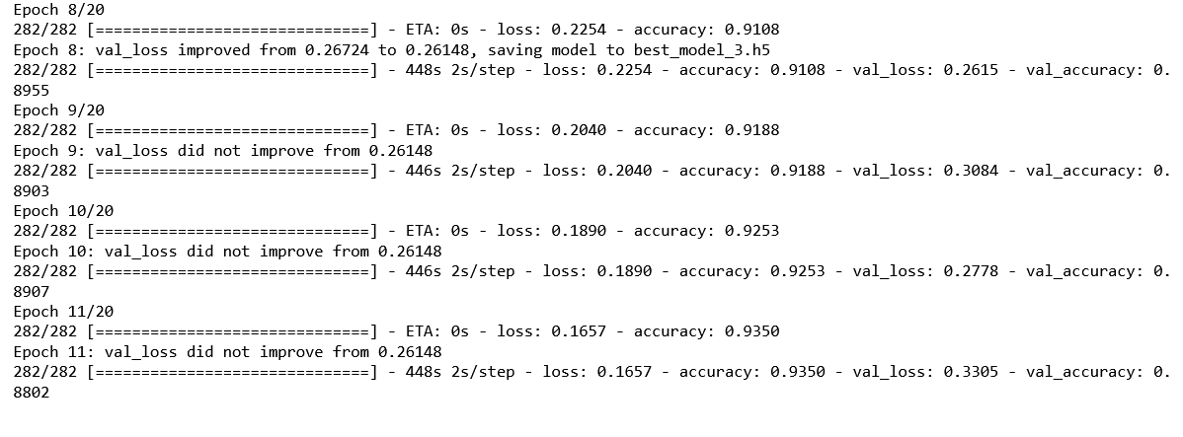
results

Slide 17
CNN & Bidirectional GRU & LSTM with Attention mechanisms
Input Layer: Takes in the data.
Embedding Layer: Converts integers into dense vectors.
Dropout Layer: Applies dropout across the spatial dimension.
Bidirectional GRU and LSTM Layers: Capture both past and future context in the sequence.
Dense Layer and Activation Layer: Computes a score and applies the softmax activation function.
Concatenate Layer: Merges the outputs of the two TimeDistributed Dense layers.
TimeDistributed Dense Layer: Applies a Dense operation to every temporal slice of an input.
Padding Layer: Ensures equal sequence lengths for GRU and LSTM layers.
Concatenate Layer: Merges the context vector and the LSTM output.
Conv1D Layer: Applies a convolution operation to the input.
GlobalAveragePooling1D and GlobalMaxPooling1D Layers: Perform global average and max pooling operations.
BatchNormalization Layer: Normalizes the activations of the previous layer.
Dense Layer: The final layer of the model, outputs the predictions.

Slide 18
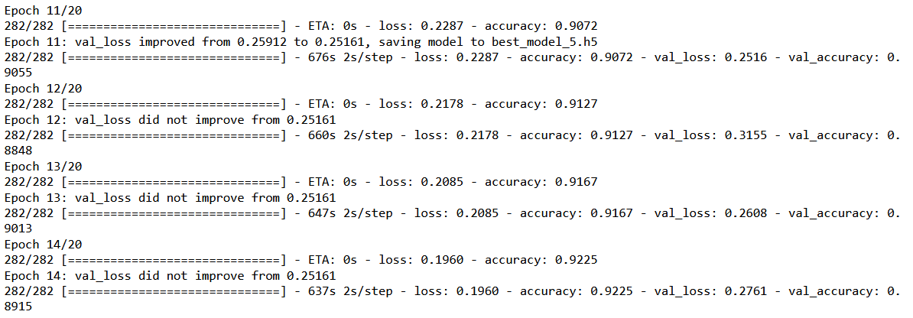
results

Slide 19

Pretrained Models
For the machine learning models we used:
Roberta
Bert

Slide 20
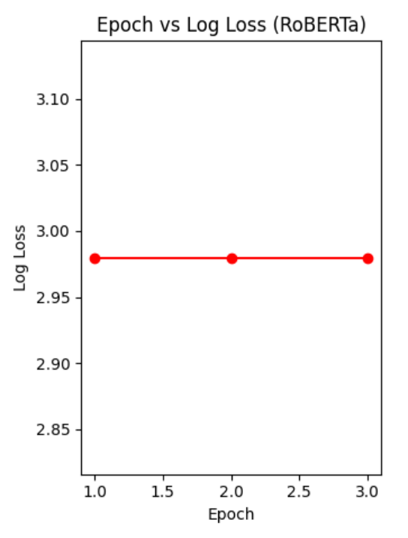
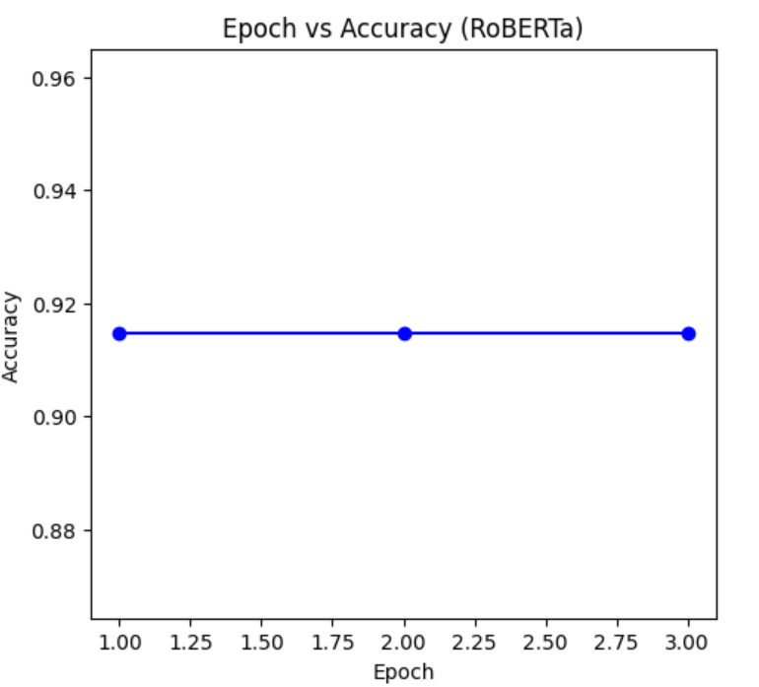
Roberta Results

Slide 21
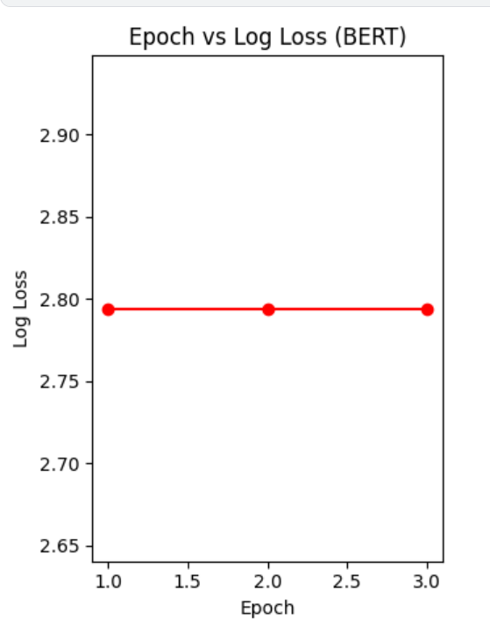
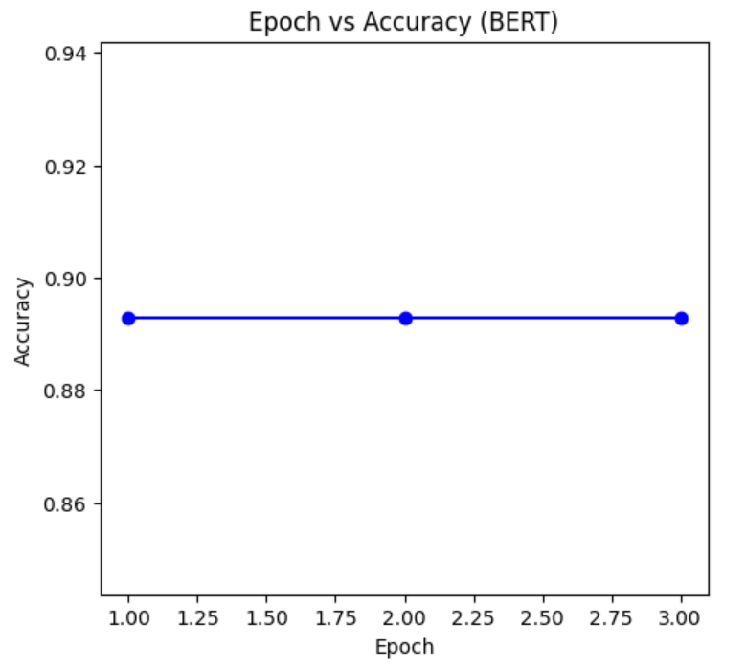
Bert Results

Slide 22
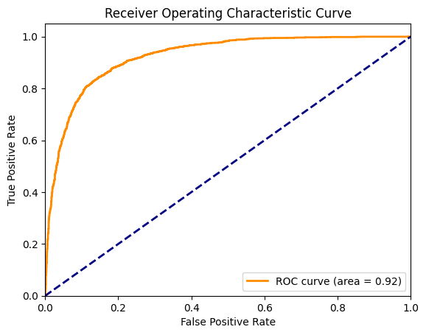
Bert For Sequence Classification

Slide 23


